Slide 1

Special Project in Big Data and Art Forgery
Dr. Scott Betz

Slide 2
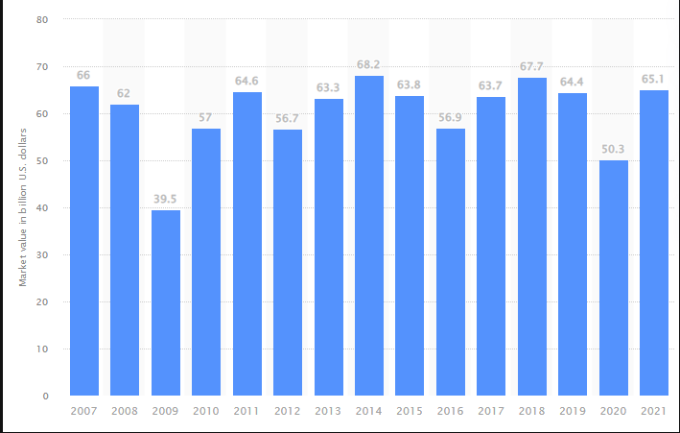
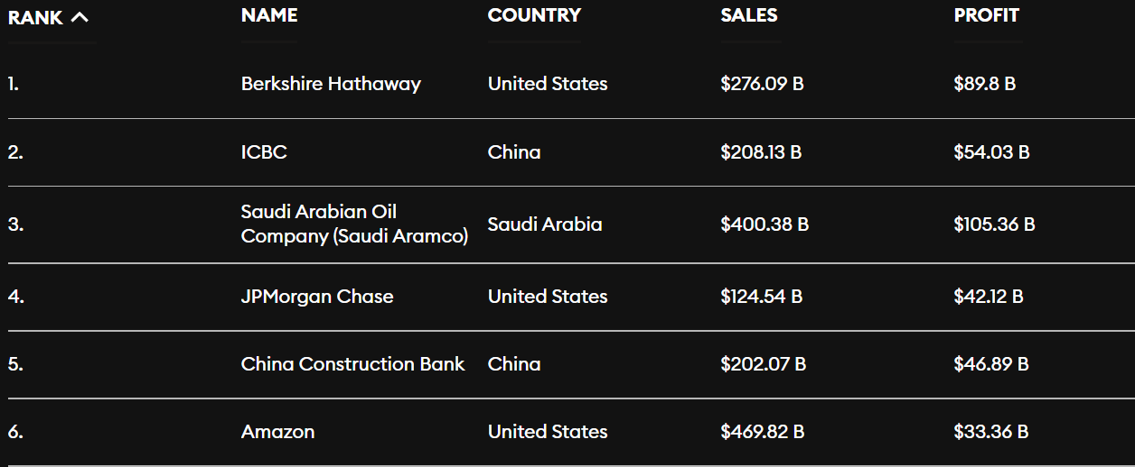
The Money In Art
The global art market value decreased significantly in 2020 over the previous year, due to the impact of the coronavirus (COVID-19) pandemic. Art and antique sales value worldwide amounted to over 64 billion U.S. dollars in 2019. In 2020, the global art market value dropped to roughly 50 billion U.S. dollars, experiencing a 22 percent decrease.
50 billion dollars is twice Australia's Gross National Product (GNP) or more than the top publicly traded companies (profit) in the world
With that much money at stake, there are bound to be some criminals that want a piece of the "action“.
Published by Statista Research Dept.
Published by Forbes

Slide 3
Criminal Activity
Art crimes can include theft and fraud. Twenty-eight years ago, two men dressed as policemen forced their way into Boston’s Isabella Stewart Gardner Museum and stole half a billion dollars’ worth of art. To this day, it’s the largest art heist ever committed— and it remains unsolved. Theft can include patience in "casing" the museum or gallery, authentic "wardrobe", guns and hostages, and the difficulty in trying to "re-sell" the stolen artwork as it will be a well-communicated and one-of-a-kind object. An easier process is FRAUD.
The 6 Most Common Art Frauds Involve:
1. Creation of fake art - by individual artists.
2. Large scale manufacture of fake art - on an industrial scale.
3. Creation of fake art materials.
4. Art galleries / fairs trading while insolvent.
5. Money laundering when purchasing art.
6. Money laundering via art market sales and auctions
In this project we will concentrate on #1. Creation of fake art - by individual artists also know as FORGERY.

Slide 4
Art Forgery
Art forgery is a divisive topic that inspires awe and anger in equal measure. While galleries, dealers, and collectors certainly don’t want fakes on their hands, it’s hard not to be impressed by painters who can imitate the greats so believably. Even with all the technology designed to verify artworks, there are still lots of convincing fakes still on display in museums around the world.
For each of the major (dead) artists whose works sell for millions of dollars, there are one or two experts (sometimes related to the artist) who have the authority to issue certificates of authenticity or to deem the works worthy of further study.
The basis for these judgments can sound surprisingly touchy-feely, involving words like "energy" or "it didn't speak to me." The experts say that this intuitive reaction is supported by a deep knowledge of the artist's materials, brushwork, color palette—even whether he or she was right- or left-handed. Though there have been cases of expert-authenticated works later proved to be fakes, there have also been cases of experts catching mistakes forensic tests missed.

Slide 5
One of the Best (Worst?) Art Forgers
John Myatt
British artist John Myatt has gone down in history as the man behind “the biggest art fraud of the 20thcentury”, as Scotland Yard put it. He painted an estimated 200 forgeries, many of which were sold by some of the biggest auction houses in the world including Sotheby’s and Phillips. His career as a forger began after he started legitimately selling counterfeits, having placed an advert for “genuine fakes” in Private Eye. Though Myatt was honest to begin with, this changed when a regular customer named John Drewe revealed that Christie’s auction house had paid £25,000 for one of Myatt’s ‘Albert Gleizes’ paintings

Slide 6
How and Who Investigates Fakes?
The uncovering of fakes by committees comprising descendants of the artist is increasingly common and has prompted one of Britain's foremost art historians to condemn the methods used by scholars to authenticate works as a "professional disgrace".
Martin Kemp, emeritus professor of art history at Oxford University and a Leonardo Da Vinci expert, said many rely on "dubious data" and that a "chaotic" approach is used to attribute paintings. He said he was alarmed at the ease with which historical, visual and scientific evidence is manipulated to suit the overriding objective – enhancing academic reputations or boosting financial rewards in attributing paintings to particular masters.

Slide 7
Art Forgery Verification Techniques
Non-Invasive Techniques Are Increasingly Popular
Ultimately, forgery operations are discovered, not by referring to gaps in the work’s provenance ordiscrepancies with the catalogue raisonné, but through scientific methods of authentication.
Using scientific methods for authentication is often a multi-layered endeavor. The first line ofauthentication utilizes non-invasive imaging techniques, such as Optical Imaging, X-ray, Infrared or UV light, that won’t damage a work.
UV Florescence
UV-induced visible fluorescence imaging is most often used to authenticate historical paintings but can be used in other mediums, as well. As they age, paints and varnishes develop fluorophores, a fluorescent chemical compound that when irradiated with long wavelength UVA lamps, will show areas of luminescence. In layman’s terms, the original work will shine brighter than retouched or restored areas.
Optical Microscope
The optical microscope allows the user to see the fine details on the surface of a work, from brushstrokes and the craquelure in varnish, to the ink patterns of a lithograph. Imperfections or an attempt at mimicry can become detectable under high magnification. Take for example, the Virgin and the Child with an Angel by Francesco Francia (1450–1517) that the National Gallery acquired in 1924as a bequest from a wealthy businessman who had allegedly purchased it from a Roman dealer. Any earlier provenance was unknown. In 1954, a second version of the painting came up for auction in London. Both versions were examined using optical microscopy, which revealed painted cracks on the surface of the 1924 version, as well as fine pencil lines in some of the detailed areas. These artistic techniques were not used in Renaissance paintings, suggesting that the 1924 version might be a forgery, although the finding remained controversial.

Slide 8
Art Forgery Verification Techniques Cont.
X-Rays
Traditional x-rays are also used to unearth hidden figures and materials underneath the surface of awork, particularly metallic and non-organic materials. As a result, many historic paintings show aghost-like image under X-Ray, but can also reveal an artist’s revisions or even abandonedcompositions on a re-used canvas.
For example, prior to 1910, the white basic pigment used to dilute and create various colorscontained lead carbonate, so a pre-1910 painting without any lead white pigment is likely to be aforgery. The Fogg Art Museum had in its collection a Portrait of a Woman by Francisco de Goya. In1954, an x-ray revealed the canvas had been re-used and underneath the painting was anotherportrait. Additional analysis showed that the buried painting contained zinc white paint, which didn’texist when Goya was alive.
Infrared Reflectography
Another optical approach is infrared reflectography, a technique that fires wavelengths of radiationinto the artwork to reveal what’s underneath the surface. Artist materials are somewhat transparent,so by using long wavelength radiation, we can see through them into each of the underlying layers.
Before commencing a work, painters often sketch the scene on the canvas and with Infraredcameras, and we can see these initial drawings. Infrared can also show the height of the craquelureand its pattern across the surface of a work. Naturally occurring cracks create a pattern perpendicularto radiating lines of stress that originate in the corners of the canvas on a frame. Faked cracks notrelated to stresses, on the other hand, are detectable in the infrared image.

Slide 9
One of the Simplest Techniques to Analye Fakes: Left-Hand/Right-Hand Analysis
Read the following article on Martin Kemp, a leading scholar and authenticator of Leonardo Da Vinci: Link to Article
“Martin Kemp made a habit of cataloguing the mistakes of Leonardo’s imitators and forgers: an inadvertent right-handed brushstroke”
“Martin Kemp looked closely at the shading—it seemed to have been drawn with a left hand, just as Leonardo had done.”
“Not only had the drawing apparently been done with left-handed strokes; the artist, like Leonardo, had relied on the palm of his hand as a way of softening the shading.”

Slide 10
What is Being Done at More Sophisticated Levels
In a new paper ,researchers from Rutgers University (including Dr. Ahmed Elgammal) and the Atelier for Restoration & Research of Paintings in the Netherlands document how their system broke down almost 300 line drawings by Picasso, Matisse, Modigliani, and other famous artists into 80,000 individual strokes. Then a deep recurrent neural network (RNN) learned what features in the strokes were important to identify the artist.
You may check out this presentation on Artificial Intelligence and Art Recognition by Dr. Elgammal.

Slide 11
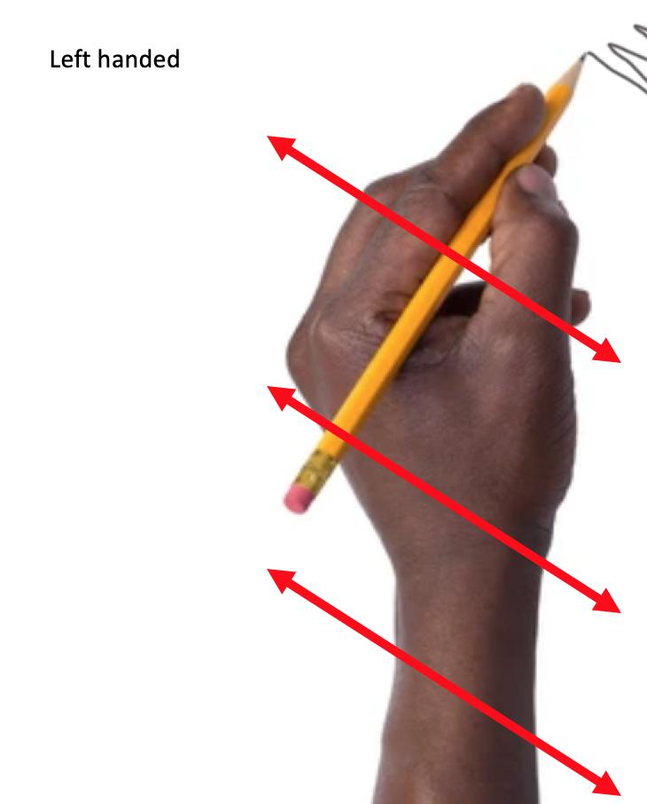
What We Can Do
80,000 stroke analyses is more than we can accomplish in our smaller project. But we can learn something about using data to detect art forgeries.
We can analyze left-handed and right-handed artists and see if we can spot a forgery. Left-handed artists usually make marks from the upper left to lower right. Right-handed artists usually make marks from the upper right to lower left.
This is because of the natural movement of the fingers, wrist and arm to swing away from the body rather than jab forward and back. See the arrows on the image as an example of left-handedness. Try it yourself on a scrap piece of paper. Do your marks swing or jab?

Slide 12
How We Can Do It
Please reference the supporting document to this presentation regarding the details of the project
This will be due by the end of the current module

